Slide 1

Lecture 6 Sampling
School of Computer Engineering and Science
Shanghai University
Instructor: Jianjia Wang, Shengyu Duan

Slide 2
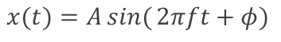

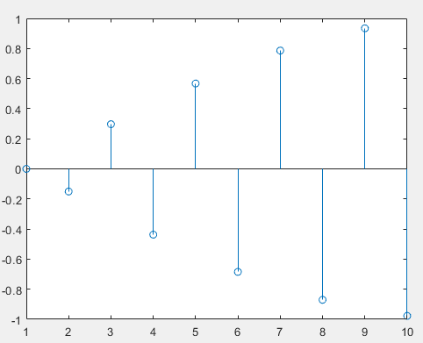
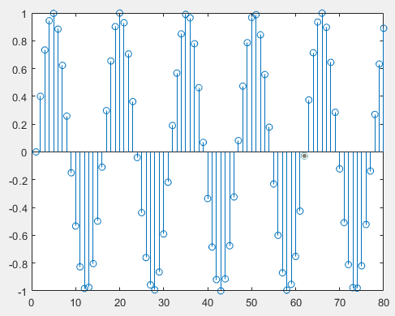
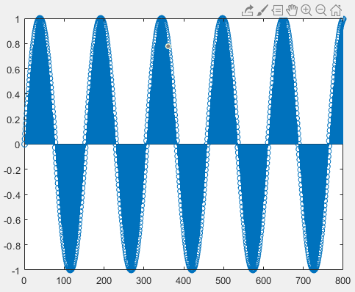
实验二 信号表示
在实验二教学PPT中，我们已学会如何根据音调的频率构建其对应的信号，信号用如下正弦波形式表示：
1）Fs=1000；2）Fs=8000；3）Fs=80000。在上述三种采样频率下，所产生的信号与声音是否有所不同？为什么？
高音C（哆）：f=524Hz
Fs=1000Hz
Fs=8000Hz
Fs=80000Hz
0.01s
0.01s
0.01s

Slide 3
实验二 信号表示
在实验二教学PPT中，我们已学会如何根据音调的频率构建其对应的信号，信号用如下正弦波形式表示：
1）Fs=1000；2）Fs=8000；3）Fs=80000。在上述三种采样频率下，所产生的信号与声音是否有所不同？为什么？
取决于给定信号的频率f：
上述结果表明采样频率Fs对信号的影响与信号本身的频率f相关。实际上，根据奈奎斯特采样定理，当Fs>2f时，任何采集到的离散时间信号都具有原始信号的全部特征，因此不同Fs无任何区别（当f取值小于500时）；Fs≤2f时，采集到的离散时间信号不具有原始信号的全部特征，则会导致声音信号失真。
若f取值较低（低于500），三种采样频率的声音无任何区别；
若500<f<4000，则Fs=1000：音调低；Fs=8000或Fs=80000，音调高且相同；
若f>4000，则Fs=1000：音调最低；Fs=8000：音调较低；Fs=80000，音调最高。（注意，f不要太取太大，否则声音太刺耳）

Slide 4
Outline: Lecture 6: Sampling
Introduction
The Sampling Theorem
Impulse train sampling
Sampling with a zero-order hold
Interpolation
Aliasing

Slide 5
Outline: Lecture 6: Sampling
Introduction
The Sampling Theorem
Impulse train sampling
Sampling with a zero-order hold
Interpolation
Aliasing

Slide 6
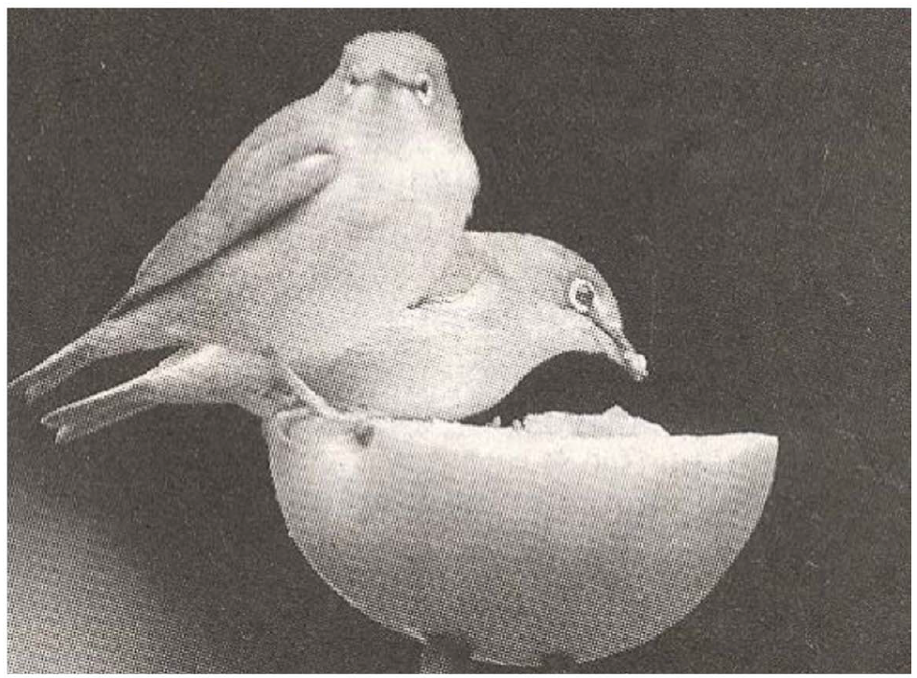
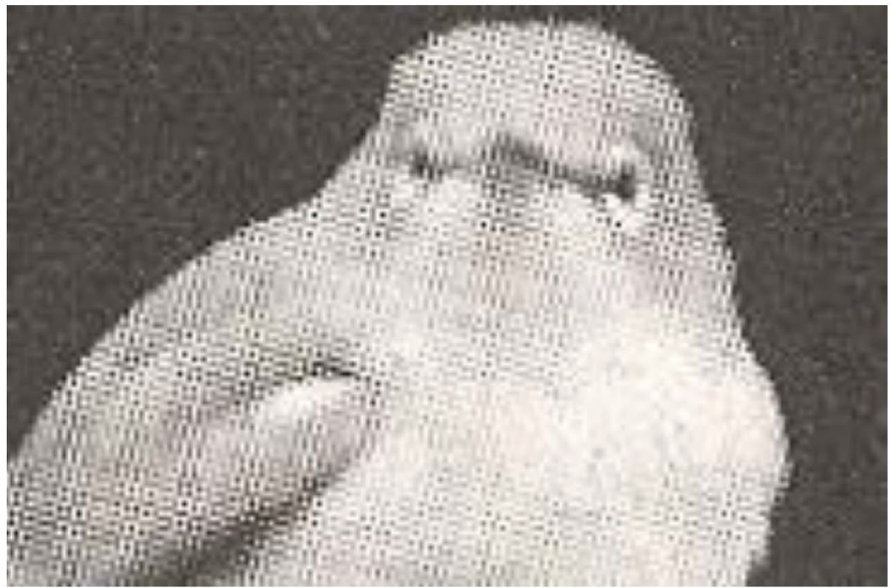
Introduction
Continuous-time signal is often represented by discrete-time signal:
- Image transmission in fax machine;
- Signals in TV display: 60Hz or beyond refresh rates;
- Film: 12 or beyond frames per second.
Zoom in

Slide 7
Introduction
Motivation: a discrete-time represented continuous-time signal can be digitally handled, using computers:
- Accurate, programmable, flexible, reproducible, powerful;
- Compatible to digital networks and relevant technologies;
- All signals look the same when digitized, except at different rates, and thus can be supported by the same network.
Question: under which conditions can a continuous-time signal be uniquely specified by its discrete-time samples?

Slide 8
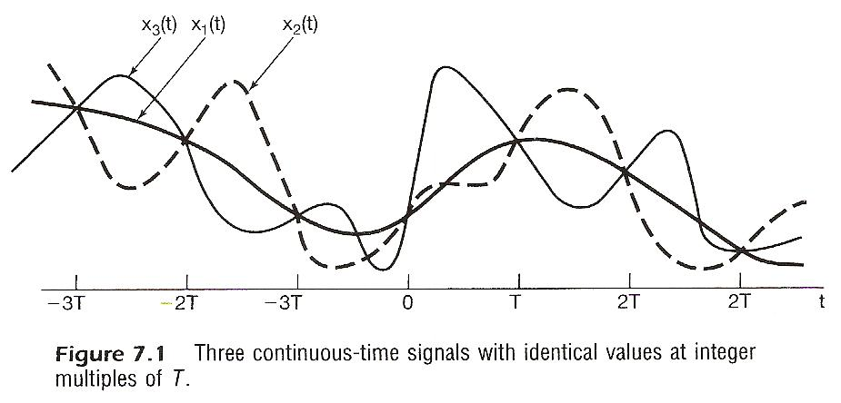
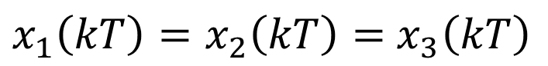
Introduction
Question: under which conditions can a continuous-time signal be uniquely specified by its discrete-time samples?
$x_{1}\left(kT\right)=x_{2}\left(kT\right)=$ $x_{3}\left(kT\right)$

Slide 9
Introduction
Question: under which conditions can a continuous-time signal be uniquely specified by its discrete-time samples?
For a given set of samples, it might be produced by different continuous-time signals.
But if a continuous-time signal is sampled in a relatively high frequency, can the samples be used to represent the signal? How high should the sampling frequency be?

Slide 10
Outline: Lecture 6: Sampling
Introduction
The Sampling Theorem
Impulse train sampling
Sampling with a zero-order hold
Interpolation
Aliasing

Slide 11
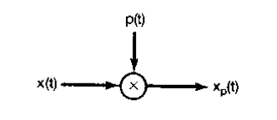
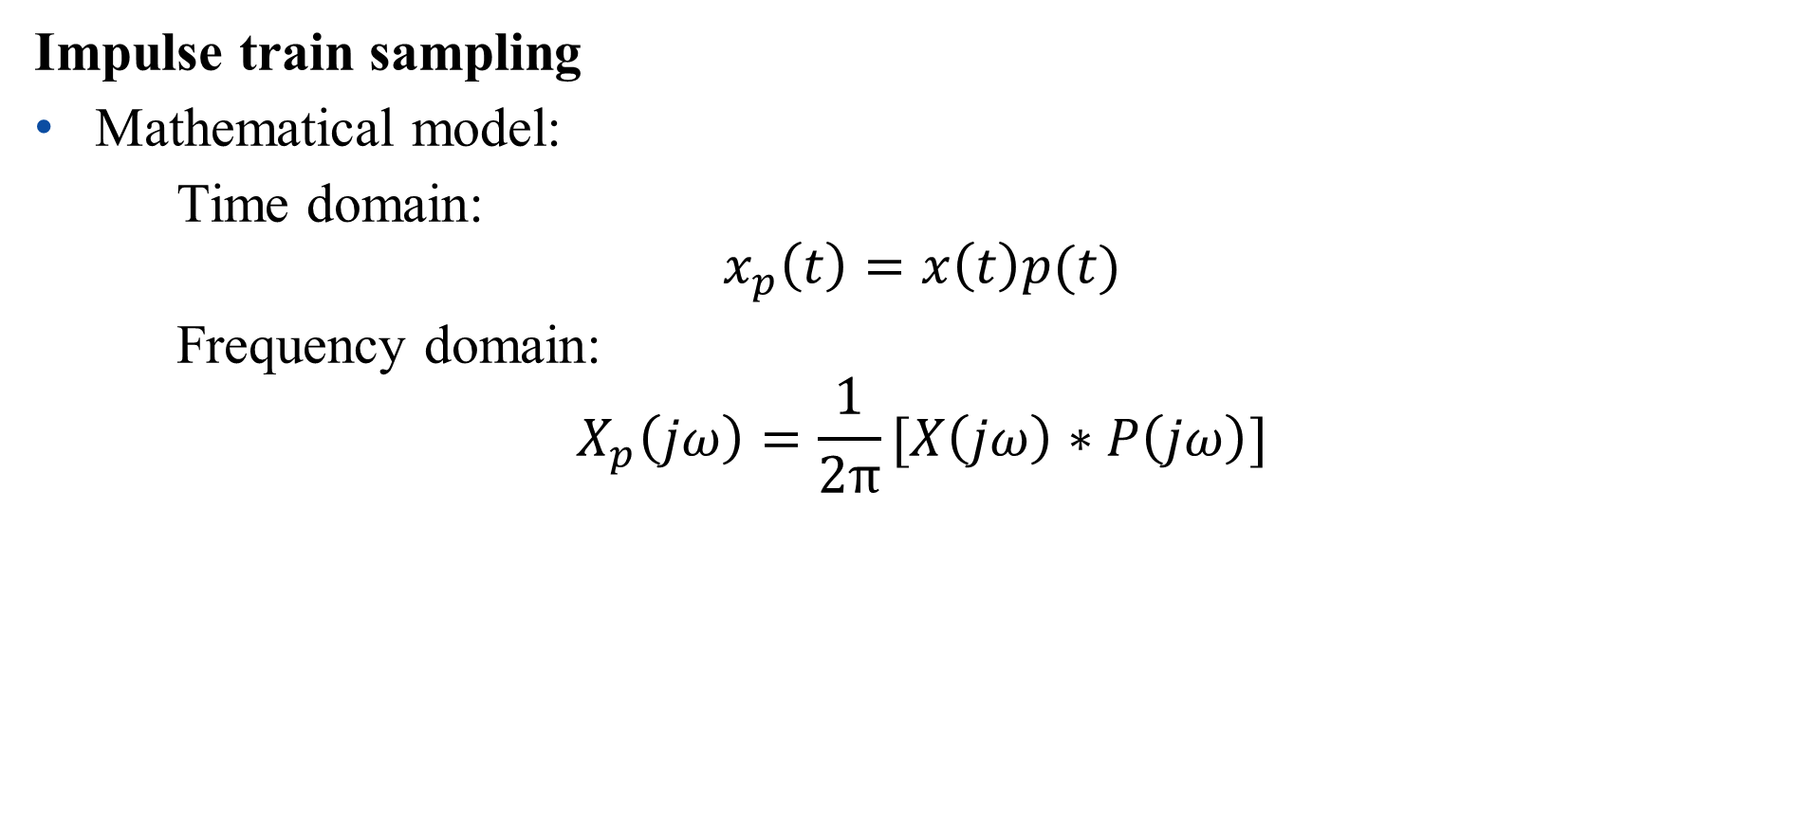
The Sampling Theorem
Impulse train sampling
Mathematical model:
Time domain:
$$x_{p}\left(t\right)=x\left(t\right)p(t)$$
Frequency domain:
$$X_{p}\left(jω\right)=\frac{1}{2π}[X\left(jω\right)∗P\left(jω\right)]$$

Slide 12
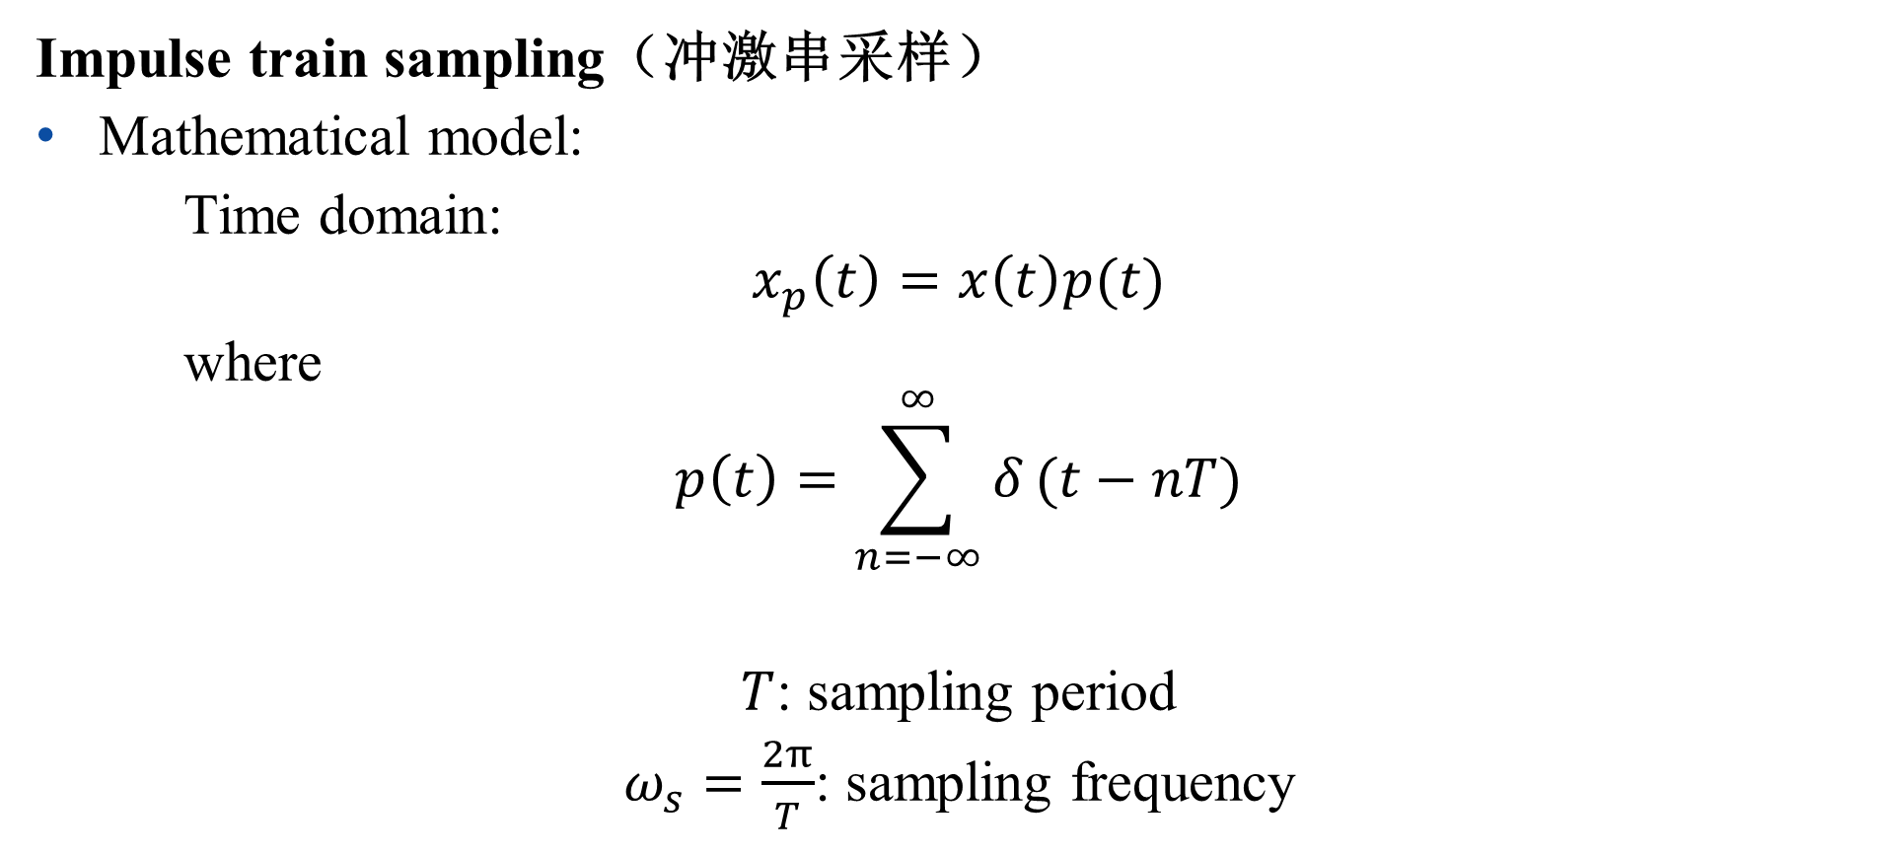
The Sampling Theorem
Impulse train sampling（冲激串采样）
Mathematical model:
Time domain:
$$x_{p}\left(t\right)=x\left(t\right)p(t)$$
where
$$p\left(t\right)=\sum_{n=−∞}^{∞}{δ}(t−nT)$$
$T$: sampling period
$ω_{s}=\frac{2π}{T}$: sampling frequency

Slide 13
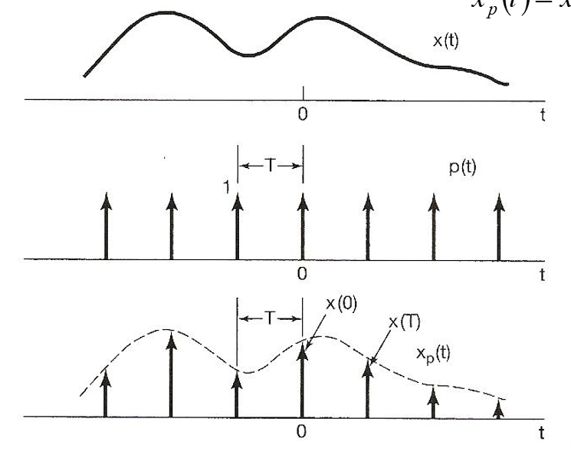
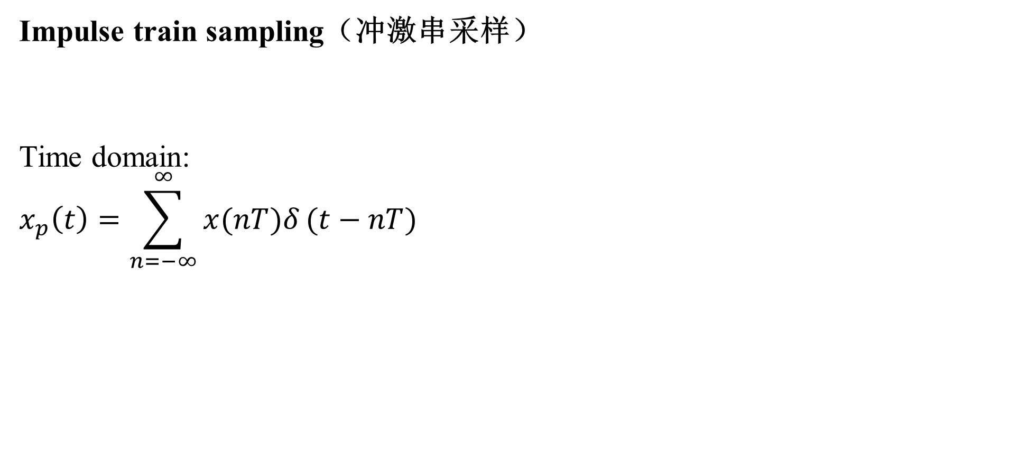
The Sampling Theorem
Impulse train sampling（冲激串采样）
Time domain:
$$x_{p}\left(t\right)=\sum_{n=−∞}^{∞}{x(nT)δ}(t−nT)$$

Slide 14
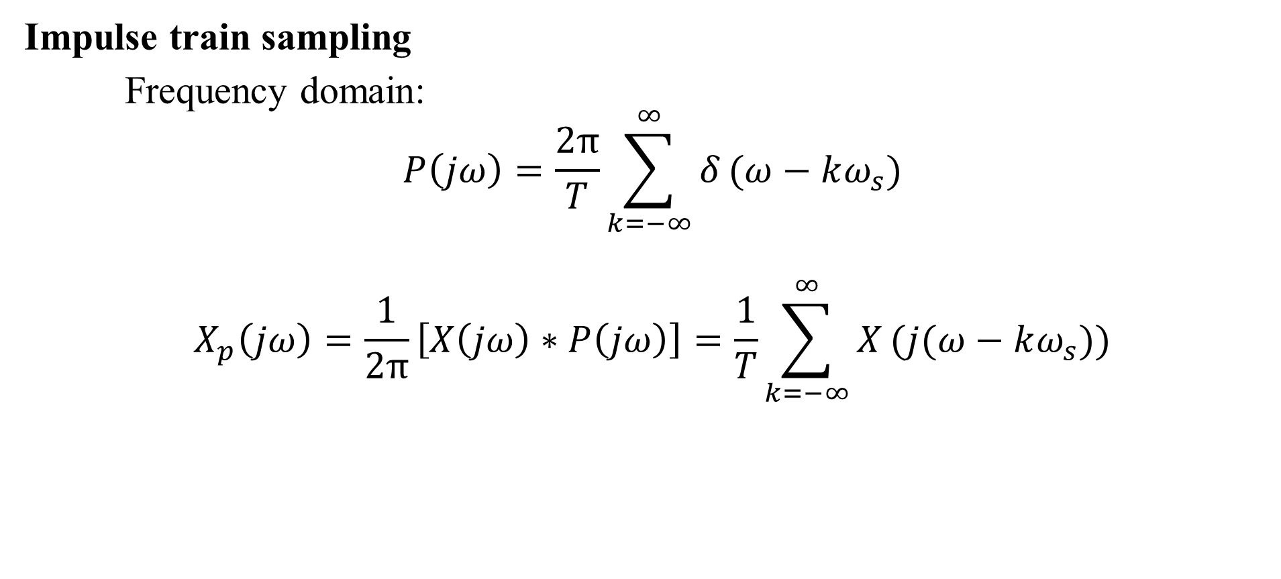
The Sampling Theorem
Impulse train sampling
Frequency domain:
$$P\left(jω\right)=\frac{2π}{T}\sum_{k=−∞}^{∞}{δ}(ω−kω_{s})$$
$$X_{p}\left(jω\right)=\frac{1}{2π}\left[X\left(jω\right)∗P\left(jω\right)\right]=\frac{1}{T}\sum_{k=−∞}^{∞}{X}(j(ω−kω_{s}))$$

Slide 15
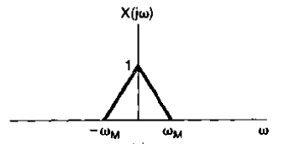
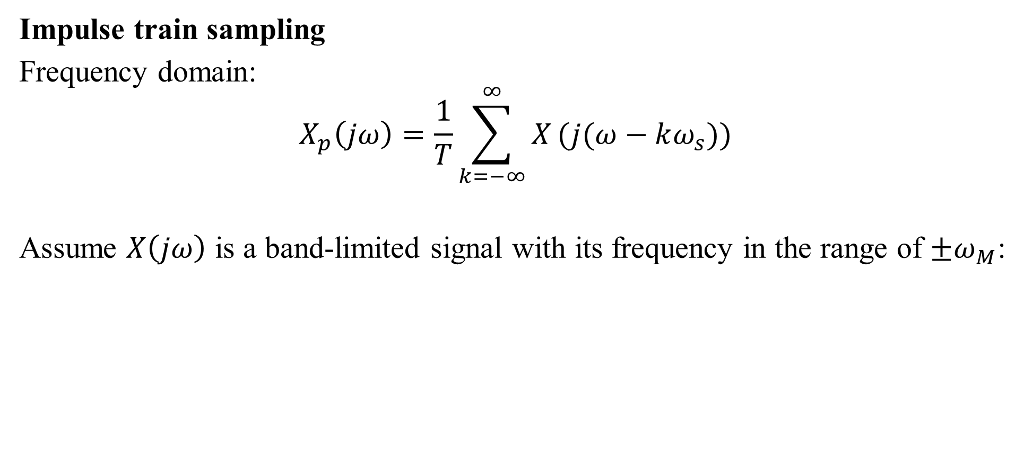
The Sampling Theorem
Impulse train sampling
Frequency domain:
$$X_{p}\left(jω\right)=\frac{1}{T}\sum_{k=−∞}^{∞}{X}(j(ω−kω_{s}))$$
Assume $X\left(jω\right)$ is a band-limited signal with its frequency in the range of $±ω_{M}$:

Slide 16
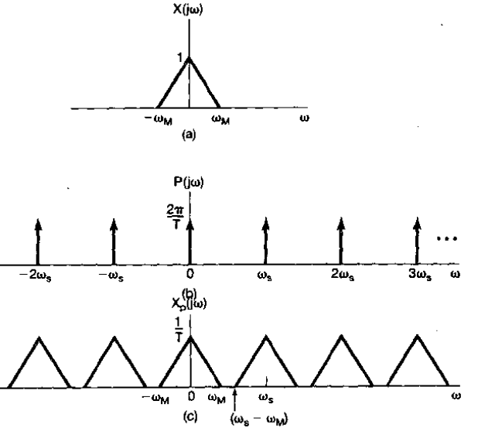
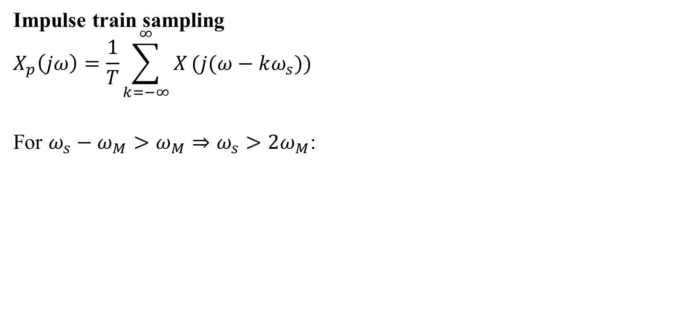
The Sampling Theorem
Impulse train sampling
$$X_{p}\left(jω\right)=\frac{1}{T}\sum_{k=−∞}^{∞}{X}(j(ω−kω_{s}))$$
For $ω_{s}−ω_{M}>ω_{M}⇒ω_{s}>2ω_{M}$:

Slide 17
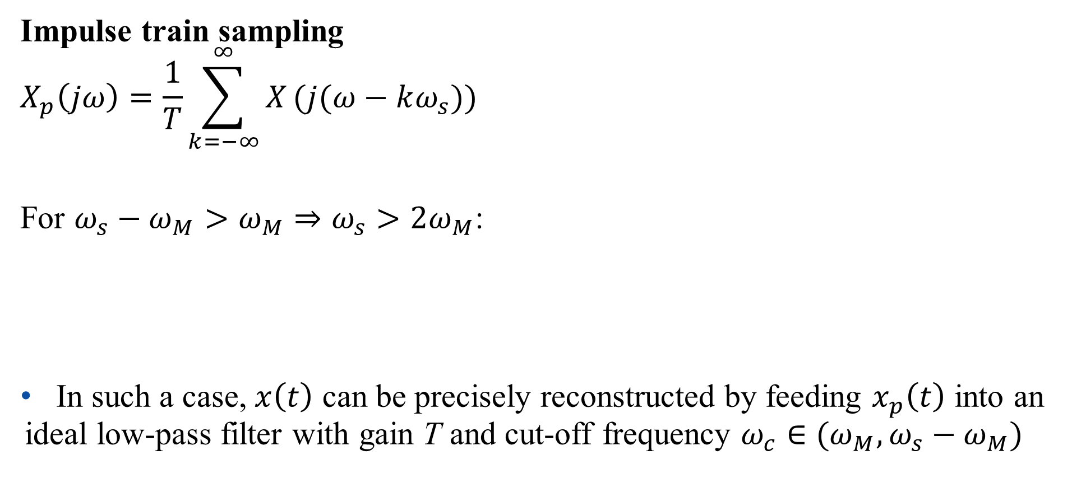
The Sampling Theorem
Impulse train sampling
$$X_{p}\left(jω\right)=\frac{1}{T}\sum_{k=−∞}^{∞}{X}(j(ω−kω_{s}))$$
For $ω_{s}−ω_{M}>ω_{M}⇒ω_{s}>2ω_{M}$:
In such a case, $x\left(t\right)$ can be precisely reconstructed by feeding $x_{p}\left(t\right)$ into an ideal low-pass filter with gain T and cut-off frequency $ω_{c}∈(ω_{M},ω_{s}−ω_{M})$

Slide 18
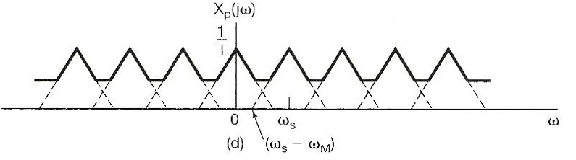
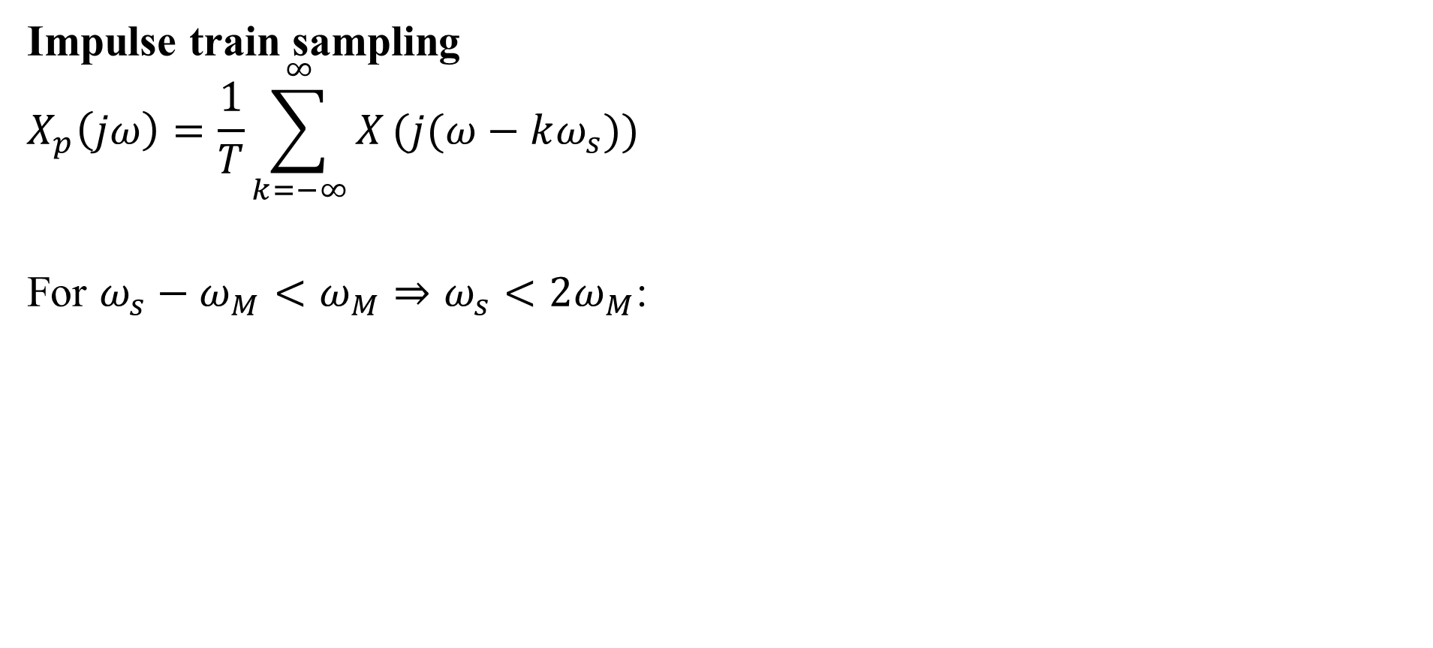
The Sampling Theorem
Impulse train sampling
$$X_{p}\left(jω\right)=\frac{1}{T}\sum_{k=−∞}^{∞}{X}(j(ω−kω_{s}))$$
For $ω_{s}−ω_{M}<ω_{M}⇒ω_{s}<2ω_{M}$:

Slide 19
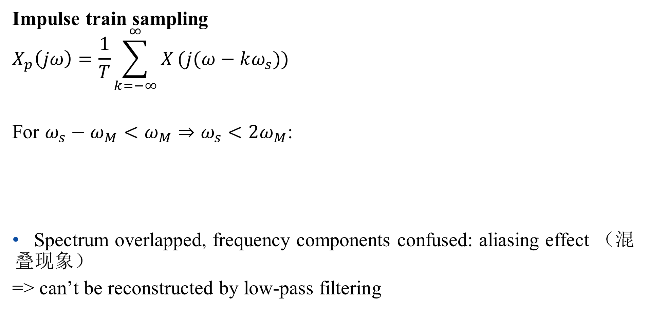
The Sampling Theorem
Impulse train sampling
$$X_{p}\left(jω\right)=\frac{1}{T}\sum_{k=−∞}^{∞}{X}(j(ω−kω_{s}))$$
For $ω_{s}−ω_{M}<ω_{M}⇒ω_{s}<2ω_{M}$:
Spectrum overlapped, frequency components confused: aliasing effect （混叠现象）
=> can’t be reconstructed by low-pass filtering

Slide 20
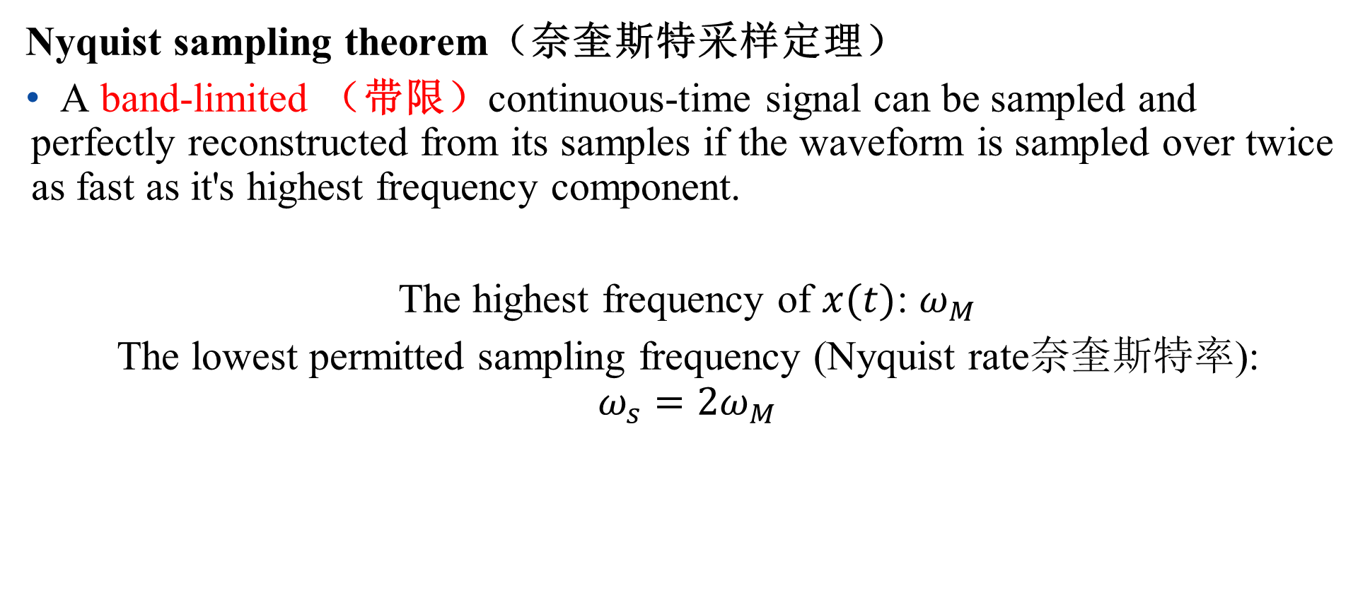
The Sampling Theorem
Nyquist sampling theorem（奈奎斯特采样定理）
A band-limited （带限）continuous-time signal can be sampled and perfectly reconstructed from its samples if the waveform is sampled over twice as fast as it's highest frequency component.
The highest frequency of $x(t)$: $ω_{M}$
The lowest permitted sampling frequency (Nyquist rate奈奎斯特率):
$$ω_{s}=2ω_{M}$$

Slide 21
The Sampling Theorem
Practical issues
Application of non-ideal low-pass filters for signal reconstruction:
- non-ideal low-pass filters need be accurate enough determined by acceptable level of distortion
In practice, signals might not be band-limited:
- pre-filtering

Slide 22
Outline: Lecture 6: Sampling
Introduction
The Sampling Theorem
Impulse train sampling
Sampling with a zero-order hold
Interpolation
Aliasing

Slide 23
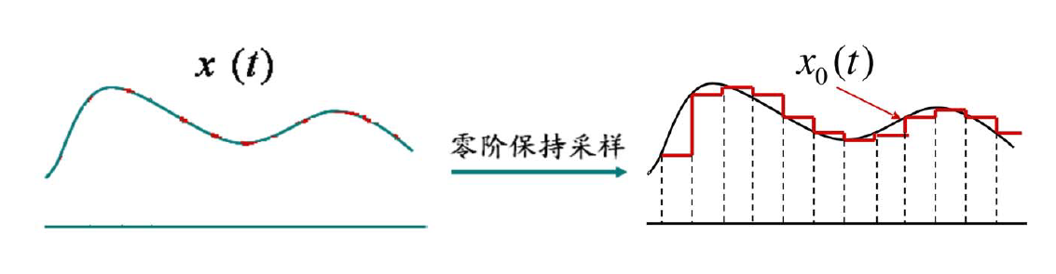
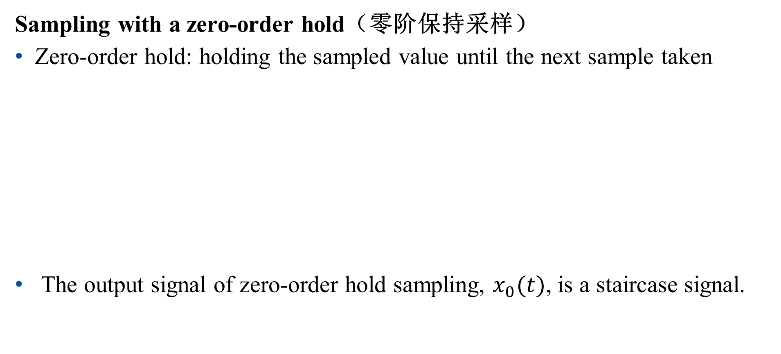
The Sampling Theorem
Sampling with a zero-order hold（零阶保持采样）
Zero-order hold: holding the sampled value until the next sample taken
The output signal of zero-order hold sampling, $x_{0}(t)$, is a staircase signal.
Sampling with zero-order hold

Slide 24
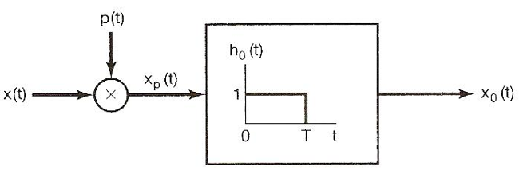

The Sampling Theorem
Sampling with a zero-order hold
Zero-order hold: modeled by an impulse train sampler followed by a system with rectangular impulse response
$$H_{0}\left(jω\right)=e^{−jωT/2}[\frac{2sin⁡(ωT/2)}{ω}]$$

Slide 25
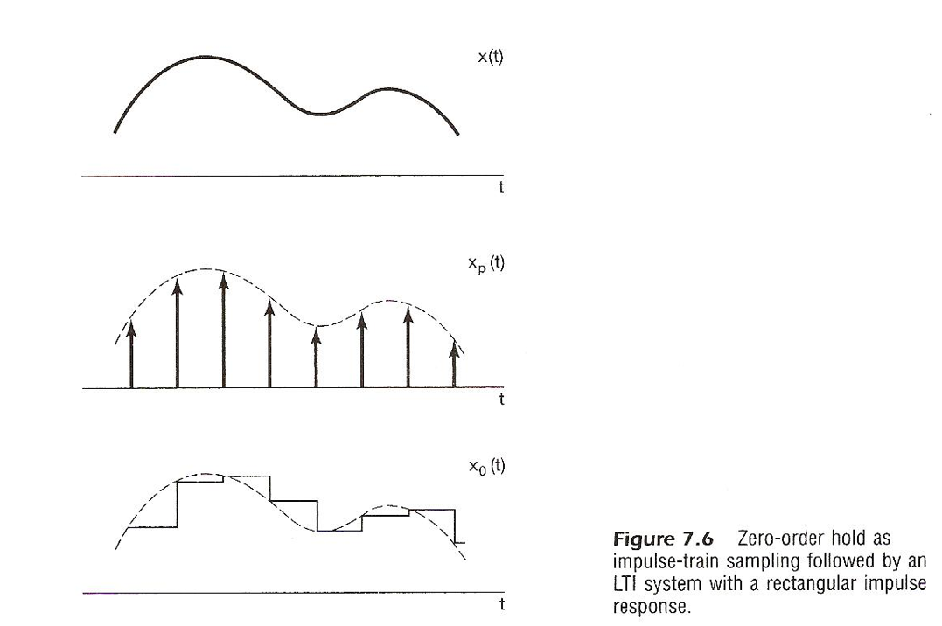
The Sampling Theorem
Sampling with a zero-order hold
Zero-order hold: modeled by an impulse train sampler followed by a system with rectangular impulse response

Slide 26
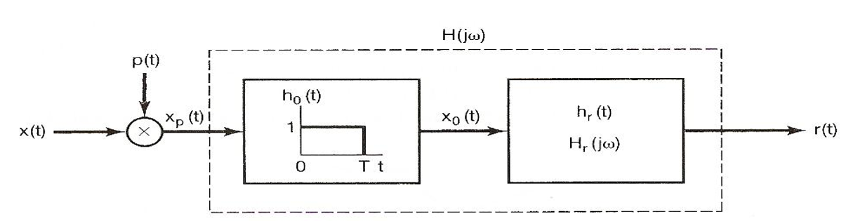

The Sampling Theorem
Sampling with a zero-order hold
Cascaded systems are required to reconstruct $x\left(t\right)$ from $x_{0}(t)$：

Slide 27
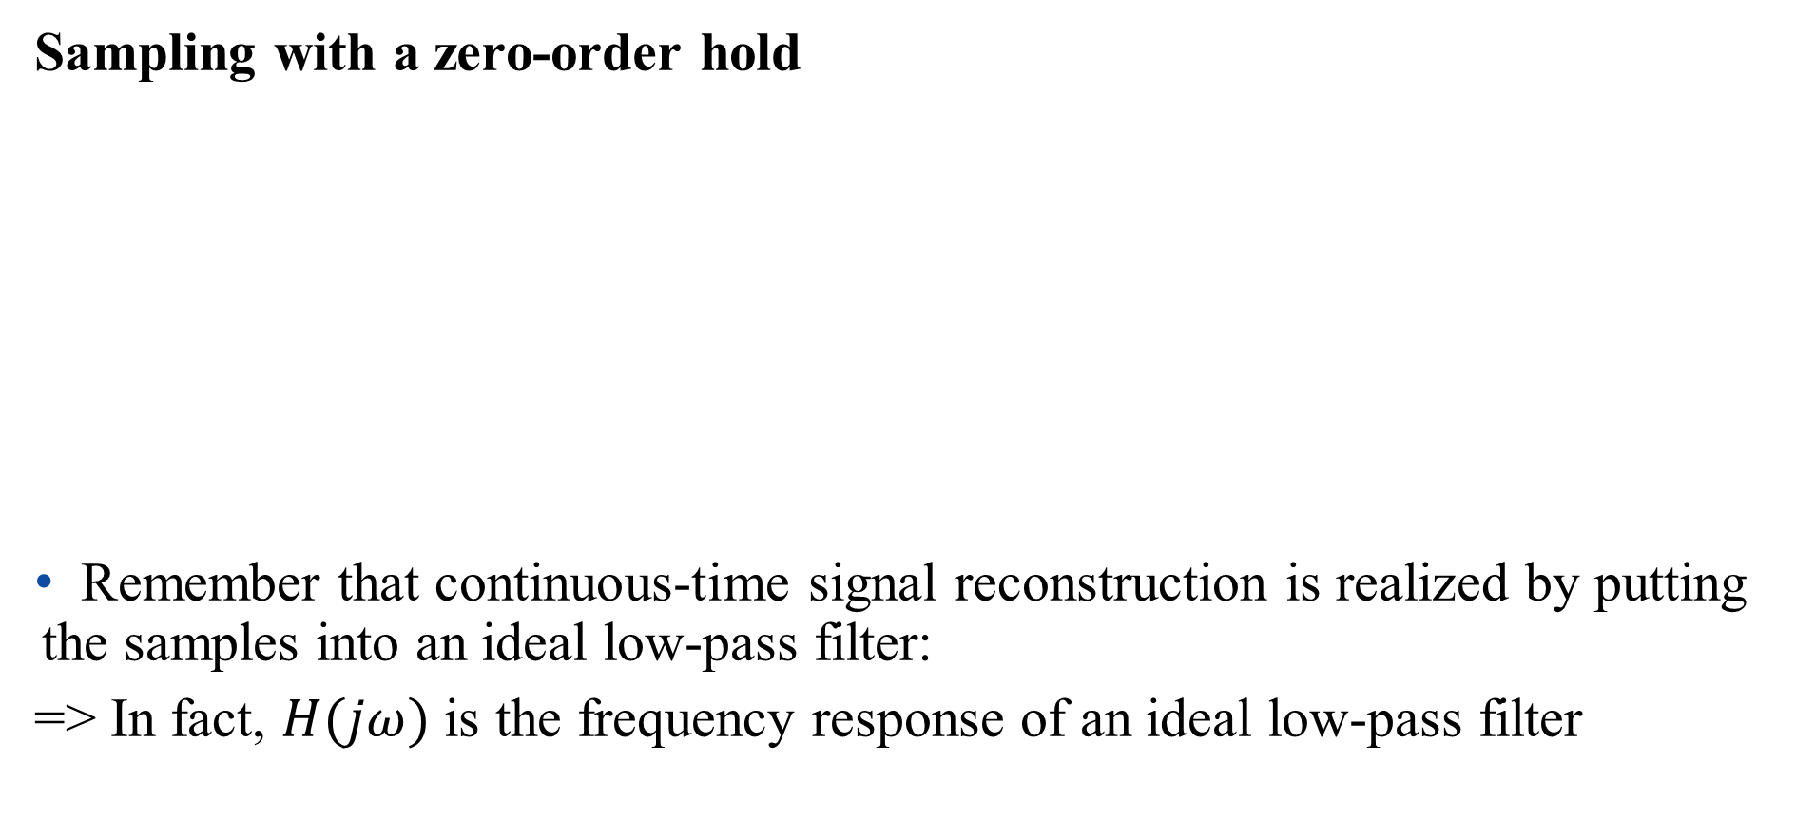
The Sampling Theorem
Sampling with a zero-order hold
Remember that continuous-time signal reconstruction is realized by putting the samples into an ideal low-pass filter:
=> In fact, $H(jω)$ is the frequency response of an ideal low-pass filter

Slide 28
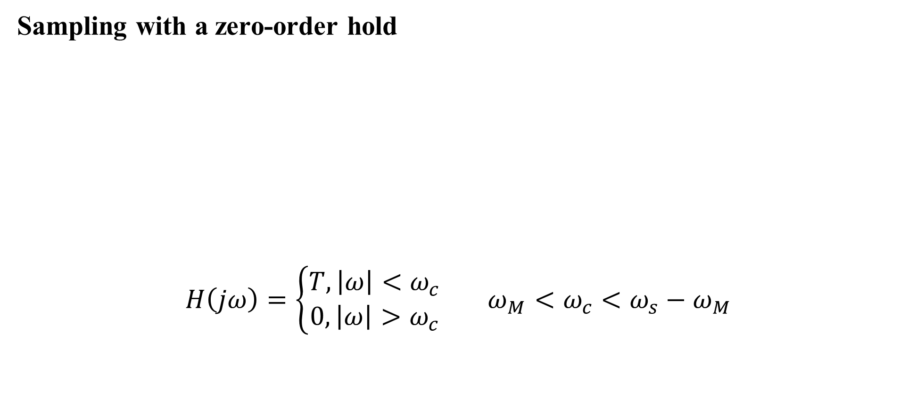
The Sampling Theorem
Sampling with a zero-order hold
$$H\left(jω\right)=\left\{\begin{aligned}T, \left|ω\right|<ω_{c} \\ 0,\left|ω\right|>ω_{c}\end{aligned}\right. ω_{M}<ω_{c}<ω_{s}−ω_{M}$$

Slide 29
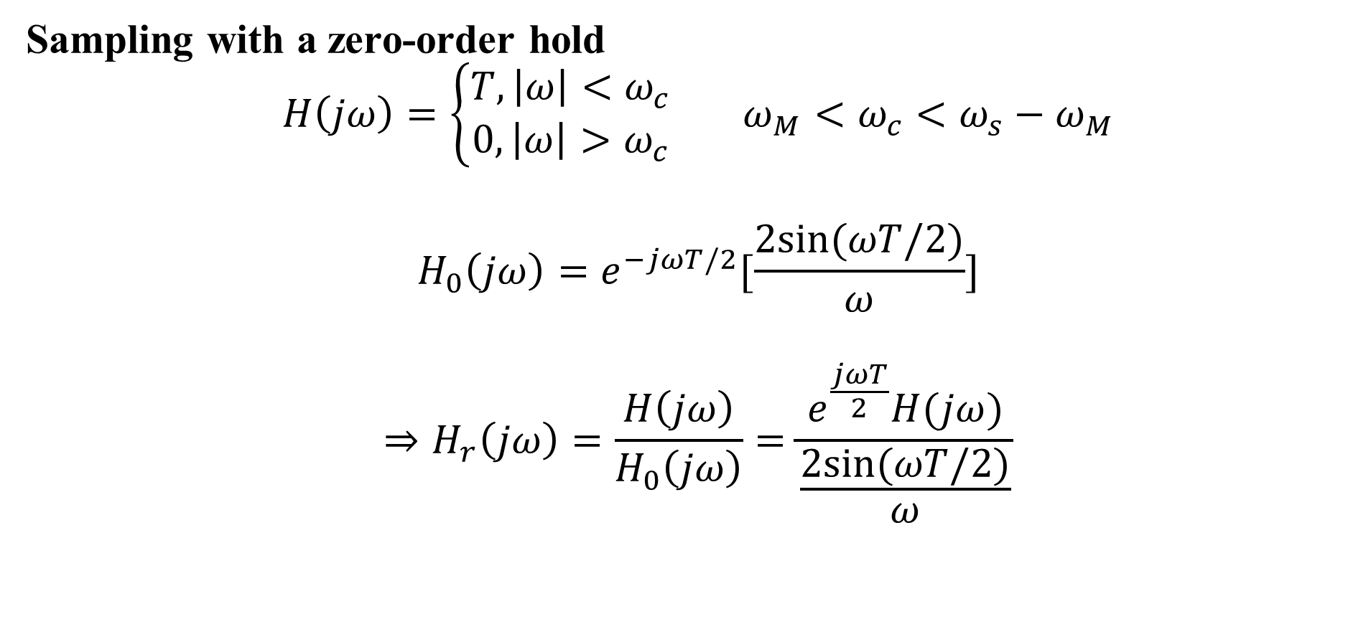
The Sampling Theorem
Sampling with a zero-order hold
$$H\left(jω\right)=\left\{\begin{aligned}T, \left|ω\right|<ω_{c} \\ 0,\left|ω\right|>ω_{c}\end{aligned}\right. ω_{M}<ω_{c}<ω_{s}−ω_{M}$$
$$H_{0}\left(jω\right)=e^{−jωT/2}[\frac{2sin⁡(ωT/2)}{ω}]$$
$$⇒H_{r}\left(jω\right)=\frac{H\left(jω\right)}{H_{0}\left(jω\right)}=\frac{e^{\frac{jωT}{2}}H(jω)}{\frac{2sin⁡(ωT/2)}{ω}}$$

Slide 30
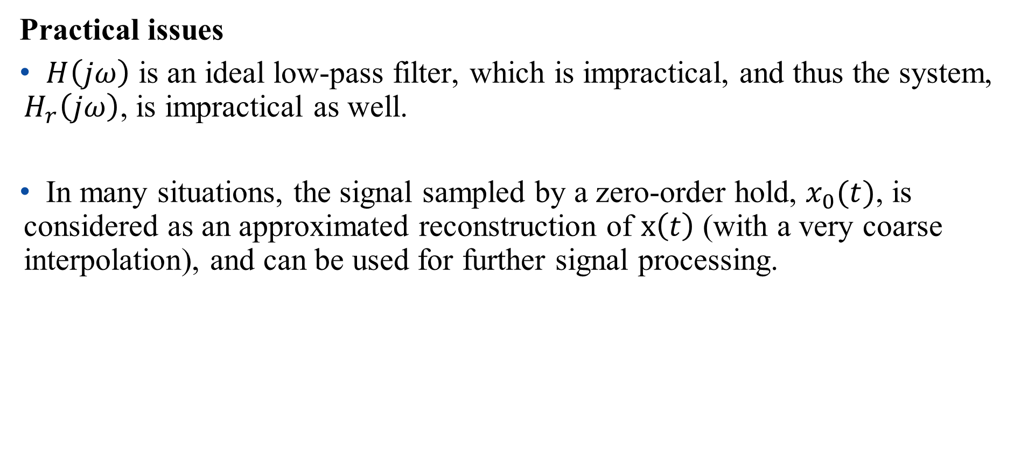
The Sampling Theorem
Practical issues
$H\left(jω\right)$ is an ideal low-pass filter, which is impractical, and thus the system, $H_{r}\left(jω\right)$, is impractical as well.
In many situations, the signal sampled by a zero-order hold, $x_{0}(t)$, is considered as an approximated reconstruction of $x\left(t\right)$ (with a very coarse interpolation), and can be used for further signal processing.

Slide 31
Outline: Lecture 6: Sampling
Introduction
The Sampling Theorem
Impulse train sampling
Sampling with a zero-order hold
Interpolation
Aliasing

Slide 32
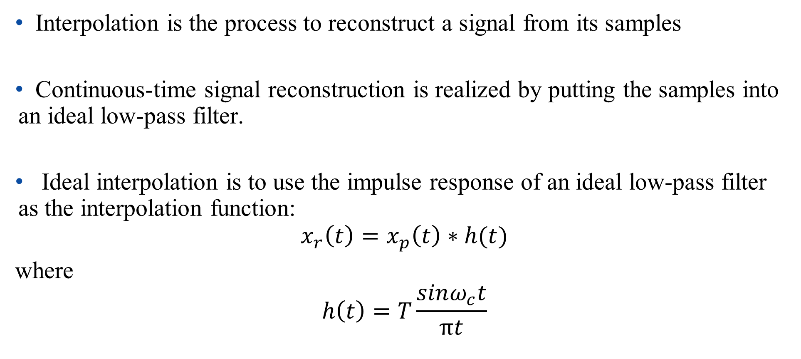
Interpolation（内插）
Interpolation is the process to reconstruct a signal from its samples
Continuous-time signal reconstruction is realized by putting the samples into an ideal low-pass filter.
Ideal interpolation is to use the impulse response of an ideal low-pass filter as the interpolation function:
$$x_{r}\left(t\right)=x_{p}\left(t\right)∗h(t)$$
where
$$h\left(t\right)=T\frac{sinω_{c}t}{πt}$$

Slide 33
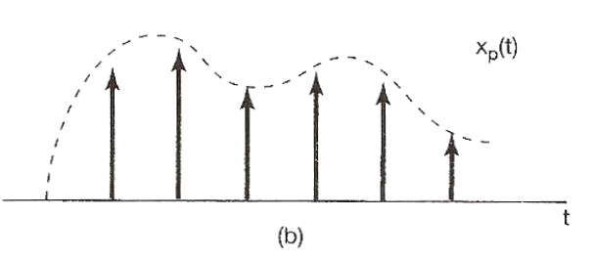
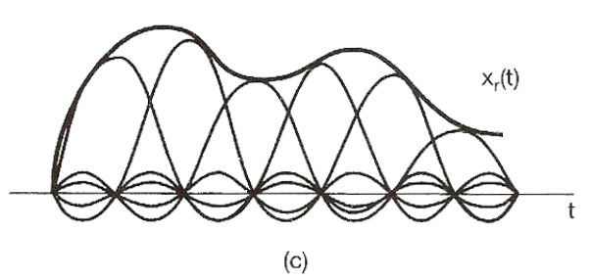
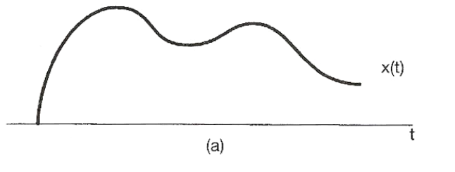
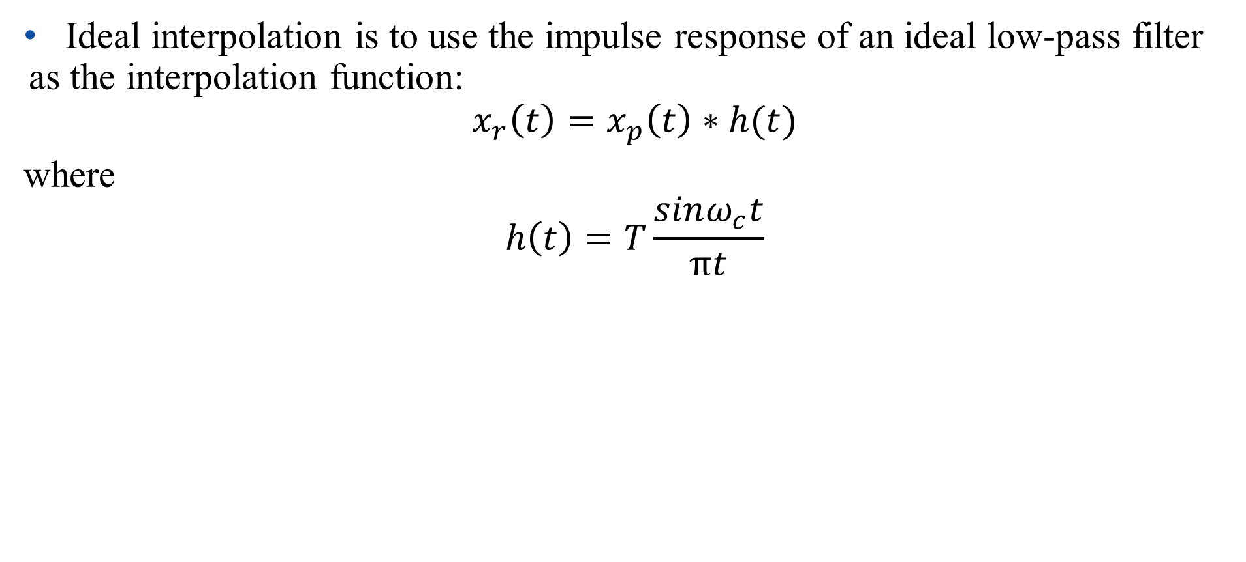
Interpolation
Ideal interpolation is to use the impulse response of an ideal low-pass filter as the interpolation function:
$$x_{r}\left(t\right)=x_{p}\left(t\right)∗h(t)$$
where
$$h\left(t\right)=T\frac{sinω_{c}t}{πt}$$

Slide 34
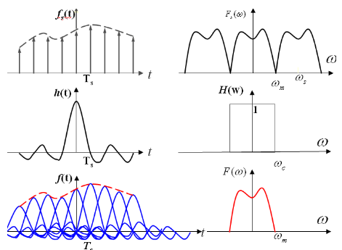
Lecture1 - 系统的因果性（Causality）
Causal: a system is causal if the output at a time, only depends on input values up to that time. （系统的输出只取决于现在的输入及过去的输入）
具有因果性的系统才是物理可实现的系统
因果性的意义：判断所设计的系统是否是可以被实现的
例：理想低通滤波器不具有因果性，是不可能被实现的

Slide 35
Lecture3 - 系统的因果性（Causality）
Causality
continuous-time
Causal iff h(t)=0,t<0

Slide 36
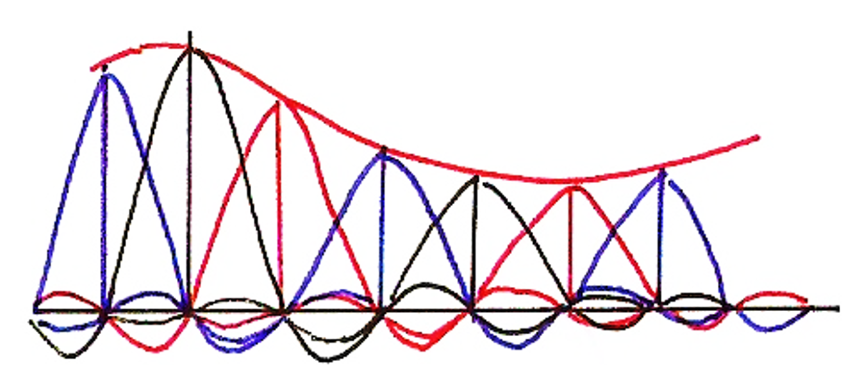
Interpolation
Ideal interpolation:

Slide 37
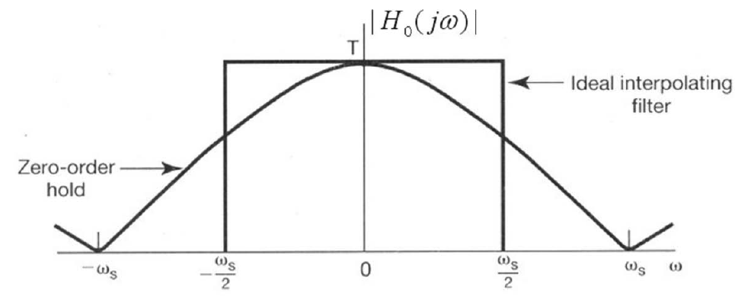
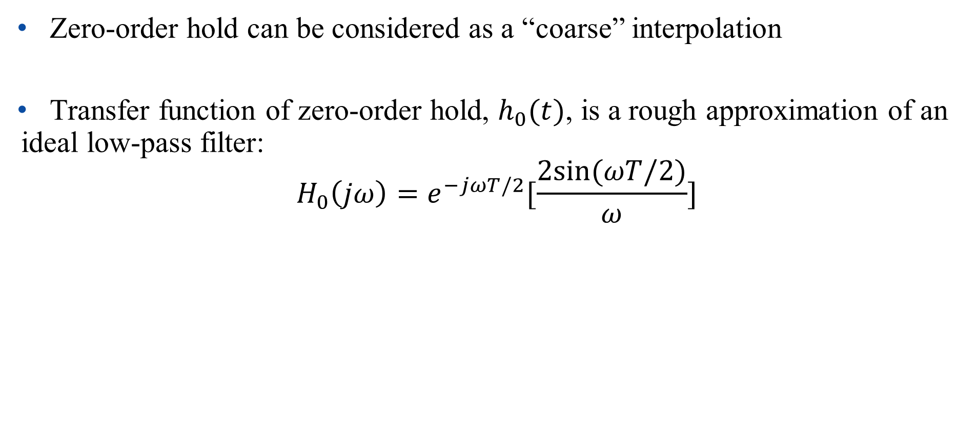
Interpolation
Zero-order hold can be considered as a “coarse” interpolation
Transfer function of zero-order hold, $h_{0}(t)$, is a rough approximation of an ideal low-pass filter:
$$H_{0}\left(jω\right)=e^{−jωT/2}[\frac{2sin⁡(ωT/2)}{ω}]$$

Slide 38
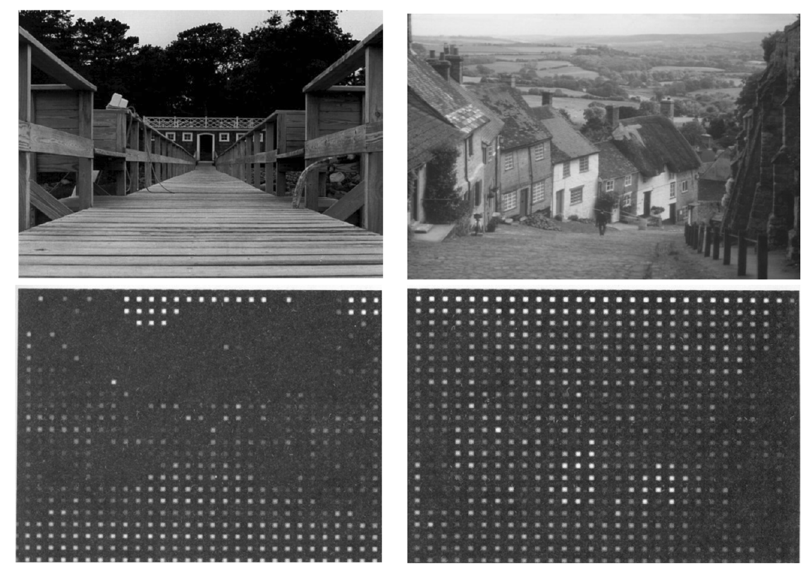
Interpolation
Original pictures:
Impulse train sampled pictures:

Slide 39
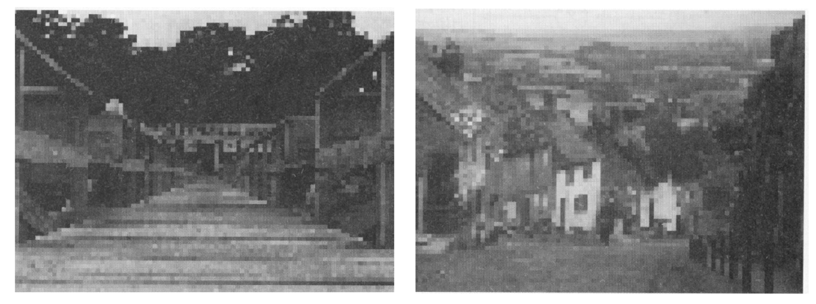
Interpolation
Original pictures:
Zero-order hold sampled pictures:

Slide 40
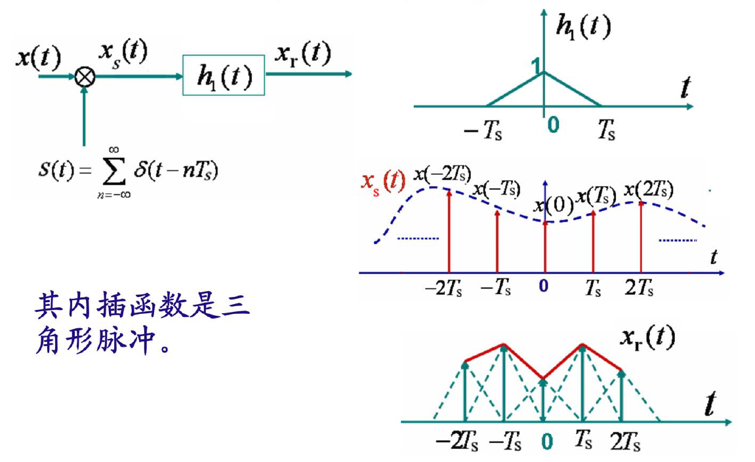
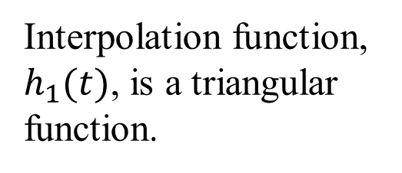
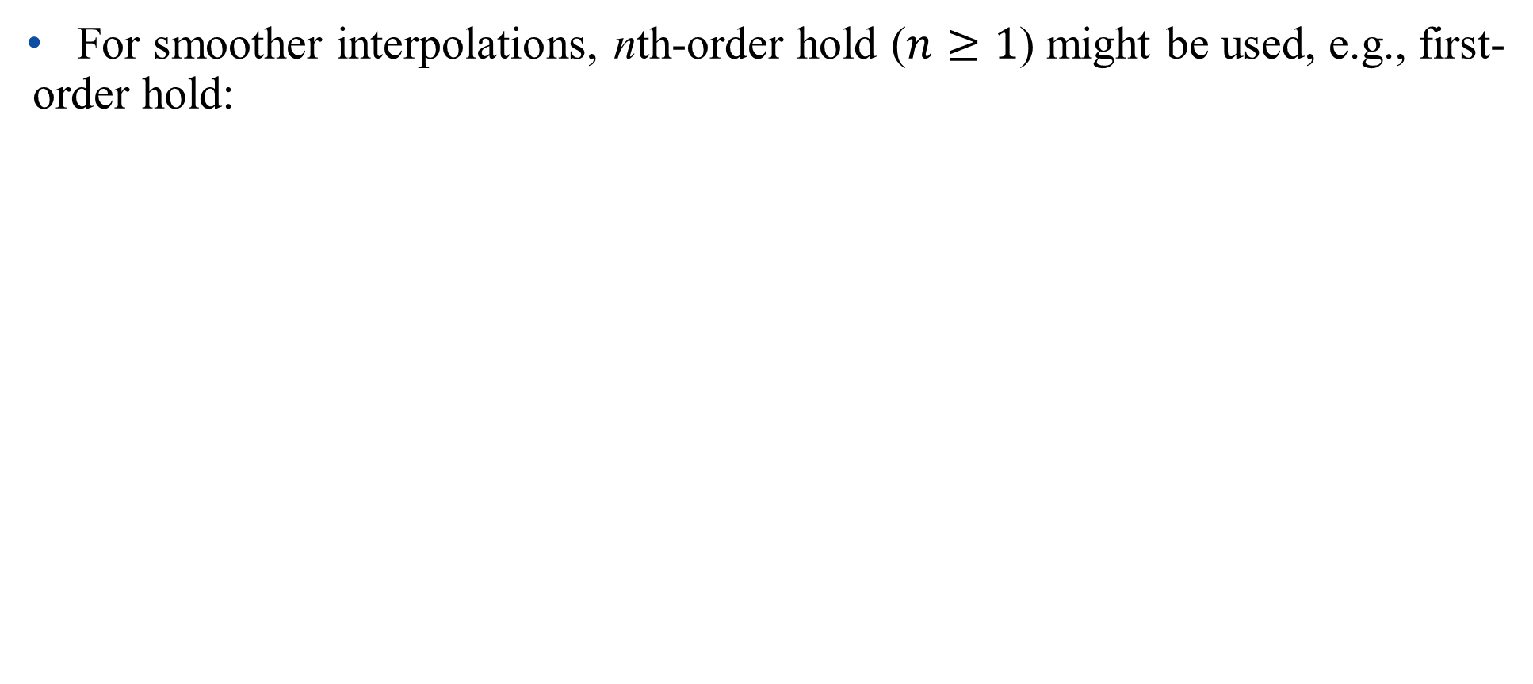
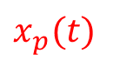
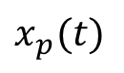
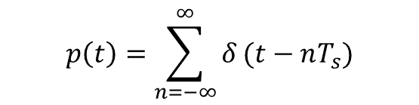
Interpolation
For smoother interpolations, nth-order hold ($n≥1$) might be used, e.g., first-order hold:
$$x_{p}(t)$$
$$p\left(t\right)=\sum_{n=−∞}^{∞}{δ}(t−nT_{s})$$
$$x_{p}(t)$$
Interpolation function, $h_{1}(t)$, is a triangular function.

Slide 41
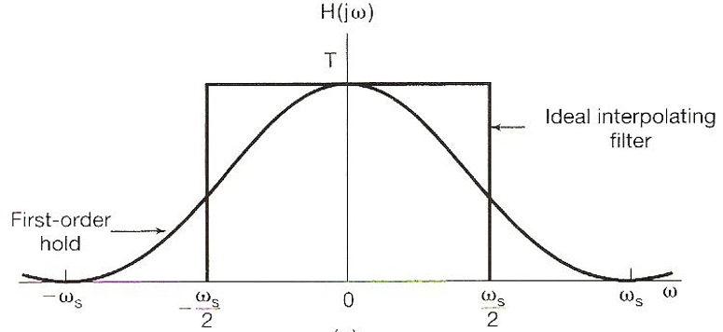

Interpolation
Transfer function of first-order hold, $h_{0}(t)$, is a rough approximation of an ideal low-pass filter:
$$H\left(jω\right)=\frac{1}{T}{\left[\frac{sin⁡(ωT/2)}{ω/2}\right]}^{2}$$

Slide 42

Interpolation
Zero-order hold sampled pictures:
First-order hold sampled pictures:

Slide 43
Outline: Lecture 6: Sampling
Introduction
The Sampling Theorem
Impulse train sampling
Sampling with a zero-order hold
Interpolation
Aliasing

Slide 44

Aliasing（混叠现象）
When $ω_{s}<2ω_{M}$, spectrum overlapped, frequency components confused, resulting in aliasing effect, such that the sampled signal can’t be reconstructed by low-pass filtering.

Slide 45

Aliasing
Consider a signal $x\left(t\right)=cosω_{0}t$:
- sampled at sampling frequency $ω_{s}=\frac{2π}{T}$；
- reconstructed by an ideal low-pass filter with $ω_{c}=\frac{ω_{s}}{2}$ ;
- reconstructed signal: $x_{r}\left(t\right)$
According to Nyquist sampling theorem, $x_{r}\left(t\right)=x\left(t\right)$ if $ω_{s}>2ω_{0}$

Slide 46




Aliasing
Assume a fixed $ω_{s}$, and vary $ω_{0}$:
$$x\left(t\right)=cosω_{0}t$$
$$x_{r}\left(t\right)=cos⁡(ω_{s}{−ω}_{0})t$$

Slide 47

Aliasing
Assume $x\left(t\right)=cos⁡(ω_{0}t+φ)$
$$x\left(t\right)=\cos\left(ω_{0}t+φ\right)=\frac{1}{2}(e^{j\left(ω_{0}t+φ\right)}+e^{−j\left(ω_{0}t+φ\right)})$$
Using the Fourier transform:
$$e^{jω_{0}t} \underset{↔}{F}2πδ(ω−ω_{0})$$
$$e^{−jω_{0}t} \underset{↔}{F}2πδ(ω+ω_{0})$$
And the time shift property: $x(t−t_{0})\underset{↔}{F}e^{−jωt_{0}}X(jω)$

Slide 48

Aliasing
Using the Fourier transform:
$$e^{j\left(ω_{0}t+φ\right)+} \underset{↔}{F}2πδ(ω−ω_{0})e^{jφ}$$
$$e^{−j\left(ω_{0}t+φ\right)} \underset{↔}{F}2πδ(ω+ω_{0})e^{−jφ}$$
$$\cos\left(ω_{0}t+φ\right)\underset{↔}{F}πe^{jφ}δ\left(ω−ω_{0}\right)+πe^{−jφ}δ\left(ω+ω_{0}\right)$$

Slide 49

Aliasing
$$x\left(t\right)=\cos\left(ω_{0}t+φ\right)\underset{↔}{F}X\left(jω\right)=πe^{jφ}δ\left(ω−ω_{0}\right)+πe^{−jφ}δ\left(ω+ω_{0}\right)$$
After feeding the samples into low-pass filter, $ω_{0}$ and ${−ω}_{0}$ components become $ω_{0}−ω_{s}$ and ${ω_{s}−ω}_{0}$ components, respectively.

Slide 50

Aliasing
$$x\left(t\right)=\cos\left(ω_{0}t+φ\right)\underset{↔}{F}X\left(jω\right)=πe^{jφ}δ\left(ω−ω_{0}\right)+πe^{−jφ}δ\left(ω+ω_{0}\right)$$
$$X_{r}\left(jω\right)=πe^{jφ}δ\left(ω−{(ω}_{0}−ω_{s})\right)+πe^{−jφ}δ\left(ω+{(ω}_{0}−ω_{s})\right)$$
$$⇒ x_{r}\left(t\right)=\cos\left((ω_{0}−ω_{s})t+φ\right)$$

Slide 51

Aliasing
$$x\left(t\right)=\cos\left(ω_{0}t+φ\right), x_{r}\left(t\right)=\cos\left((ω_{0}−ω_{s})t+φ\right)$$
Even if $ω_{s}=2ω_{0},$ phase is changed (reversed):
$$x_{r}\left(t\right)=\cos\left(−ω_{0}t+φ\right)=\cos\left(ω_{0}t−φ\right)$$
The original signal cannot be reconstructed even if the sampling frequency is exactly twice of the highest frequency of the signal.
Nyquist sampling theorem: in order to precisely reconstruct a continuous-time signal, the sampling frequency has to be larger than twice of the highest frequency of the signal.

Slide 52
Thank you for your listening!

